Slide 1
Parkinson's Disease Detection: A Visual Exploration
This project leverages a CNN model with PPMI data to detect Parkinson’s disease.
We emphasize data visualization to reveal disease progression insights.
Our goal is to showcase feature space analysis alongside robust model performance.
Submitted by:
Nitima Garg
Antriksh Gupta

Slide 2
Project Overview
Parkinson's disease affects approximately 10 million people worldwide, with diagnosis often occurring only after significant disease progression
Visualization tools for clinicians must balance technical complexity with interpretability for effective decision support
Real-time data processing and visualization could enable continuous patient monitoring but presents technical challenges
Interactive dashboards and visual analytics are needed to help clinicians interpret model predictions in clinical context

Slide 3
Overview
Image Acquisition
1
Collect SPECT DICOM images from PPMI database.
2
Pre-processing
Apply feature scaling, normalization, and extraction.
CNN Model
3
Train the convolutional neural network on the dataset for future predictions.
4
Visualization
Create basic visualizations of the dataset's features.
Model Evaluation
5
Assess the performance of the trained model.
6
Final Visualization
Compare model predictions within the context of the overall data.

Slide 4
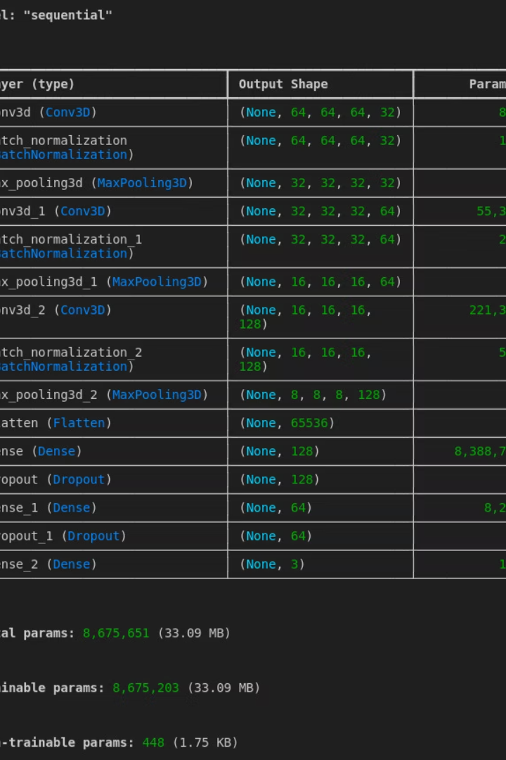
CNN Model Architecture
3D Convolution Layers
Disease Prediction
Training Process
Outputs probability estimates for Parkinson’s presence.
Trained on preprocessed 3D image data for accuracy.
Capture spatial patterns in brain scans effectively.

Slide 5
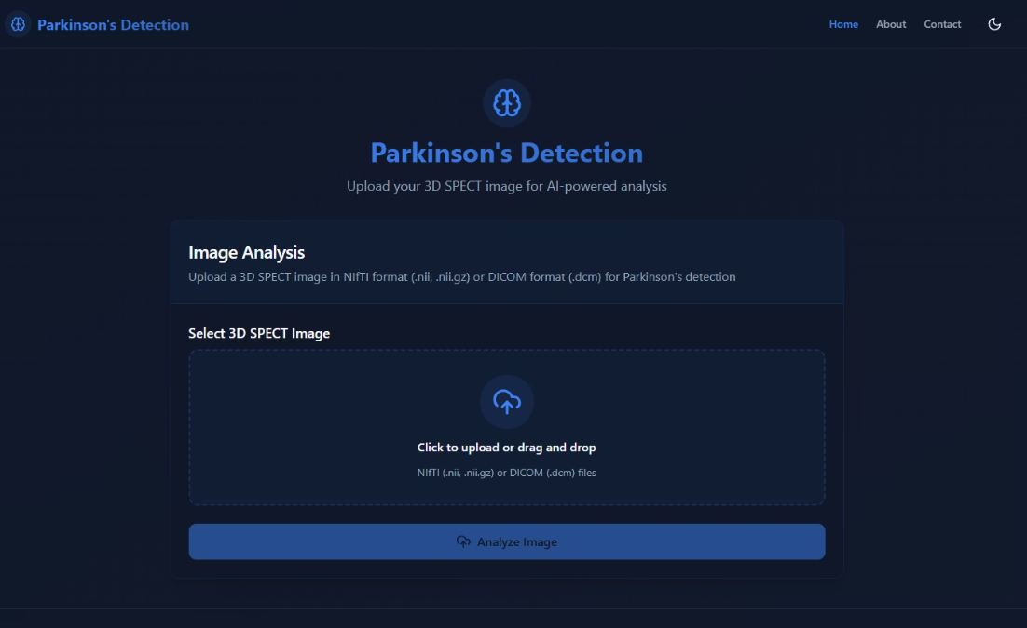
Visual documentation

Slide 6
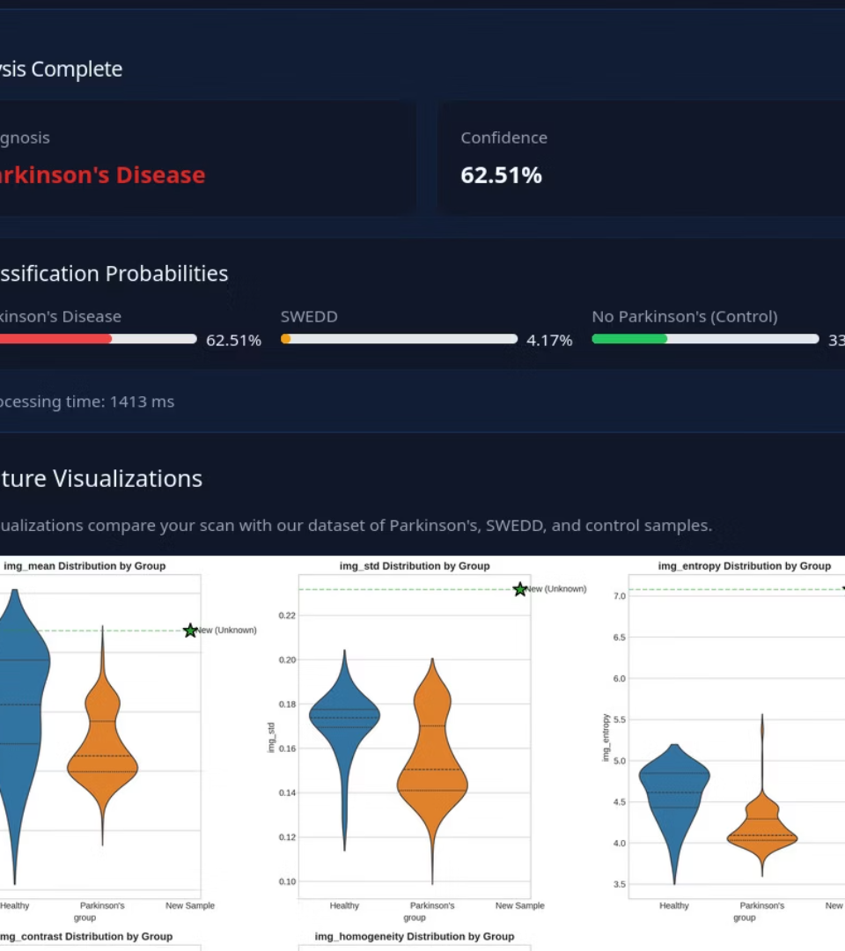
Sample file
Some of the visualizations used:
Chord diagram of feature scaling
Radar charts
Violin and Box plots
Andrews Curves of Features

Slide 7
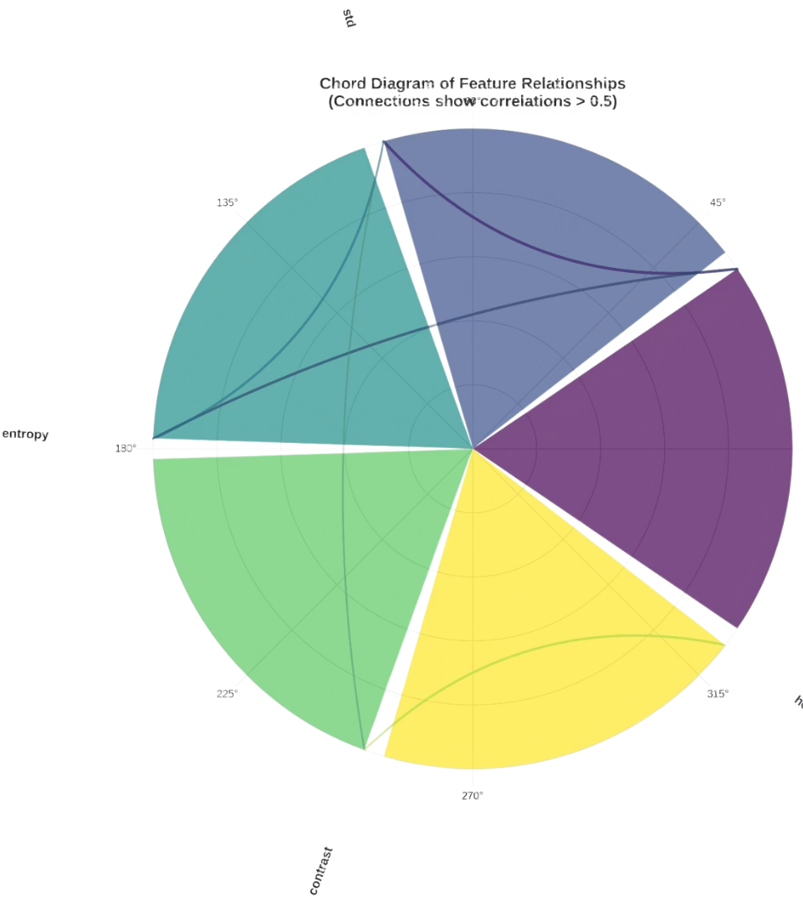
Chord diagram
Visualize correlations between features before and after scaling, helping to identify which features are strongly related and may need special handling.
In our project we have utilized this graph to depict any correlation between std,mean,entropy,contrast and homogenity
Any feature having correlation greater than 0.5 is connected in the visualization

Slide 8
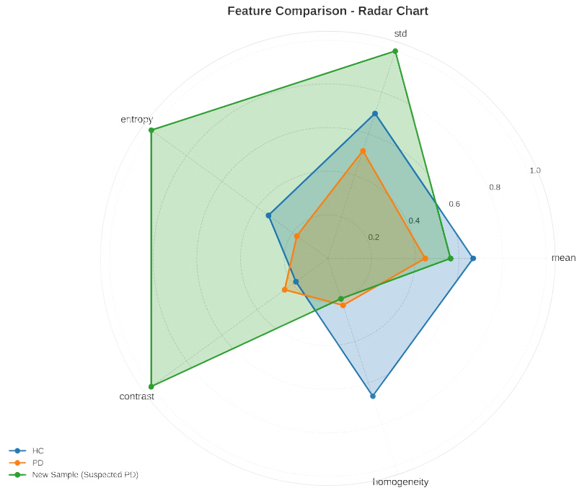
Radar chart
Great for visualizing and comparing multivariate data in a single view​​​.
Makes it easy to spot patterns, strengths, weaknesses, and outliers
The chart helps spot unusually high or low values and see which variables dominate or lag

Slide 9
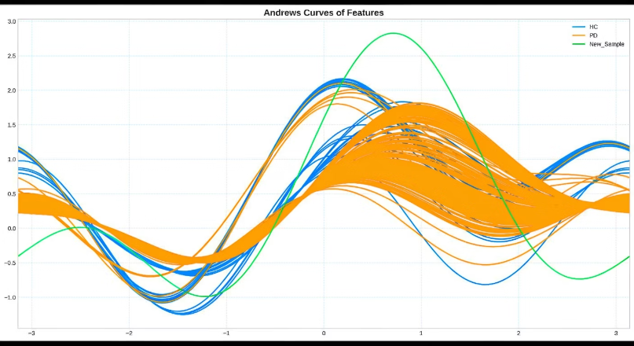
Andrews Curves of Features
Andrews curves transform high-dimensional data into smooth curves using a Fourier series, helping identify clusters and patterns
Clusters appear as groups of similar curves, while outliers stand out as isolated or distinct curves
The method can handle both continuous and categorical data

Slide 10
Key Learnings
These were some of the new types of visualizing techniques we studied while doing our project
Gained hands-on experience in implementing machine learning models
Learned to evaluate model performance using both metrics and visual tools
Improved skills in feature selection and data visualization strategies
Developed a deeper understanding of the model’s behavior through visual analysis

